Slide 1
INTRO (Summary of Report)
Aims and Objectives
A rough timetable
Current Progress
Team Roles and collaboration
Handling peer assessment and team conflicts

Slide 2
Server Hub
Client – Server application architecture
Client requests an action or service
Server provides the service
E.g. Web Server and a Web Server
Servers are passive and wait for client request

Slide 3
Task of the Hub
Connect with clients via an agreed protocol
Support for file versioning
Provide file transfer (rsync algorithm)
Probably add security by encryption

Slide 4
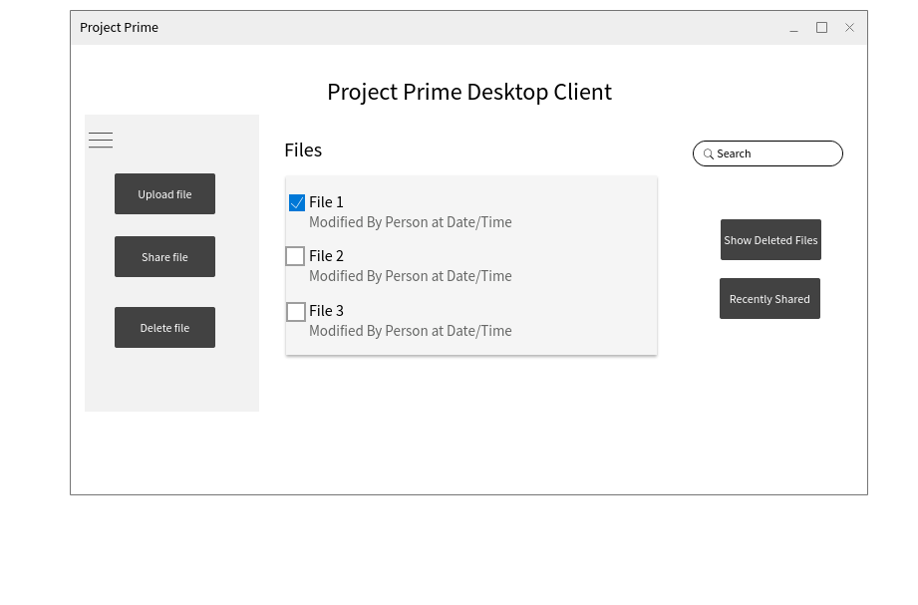
DESKTOP CLIENT

Slide 5


Tools we will use

Slide 6
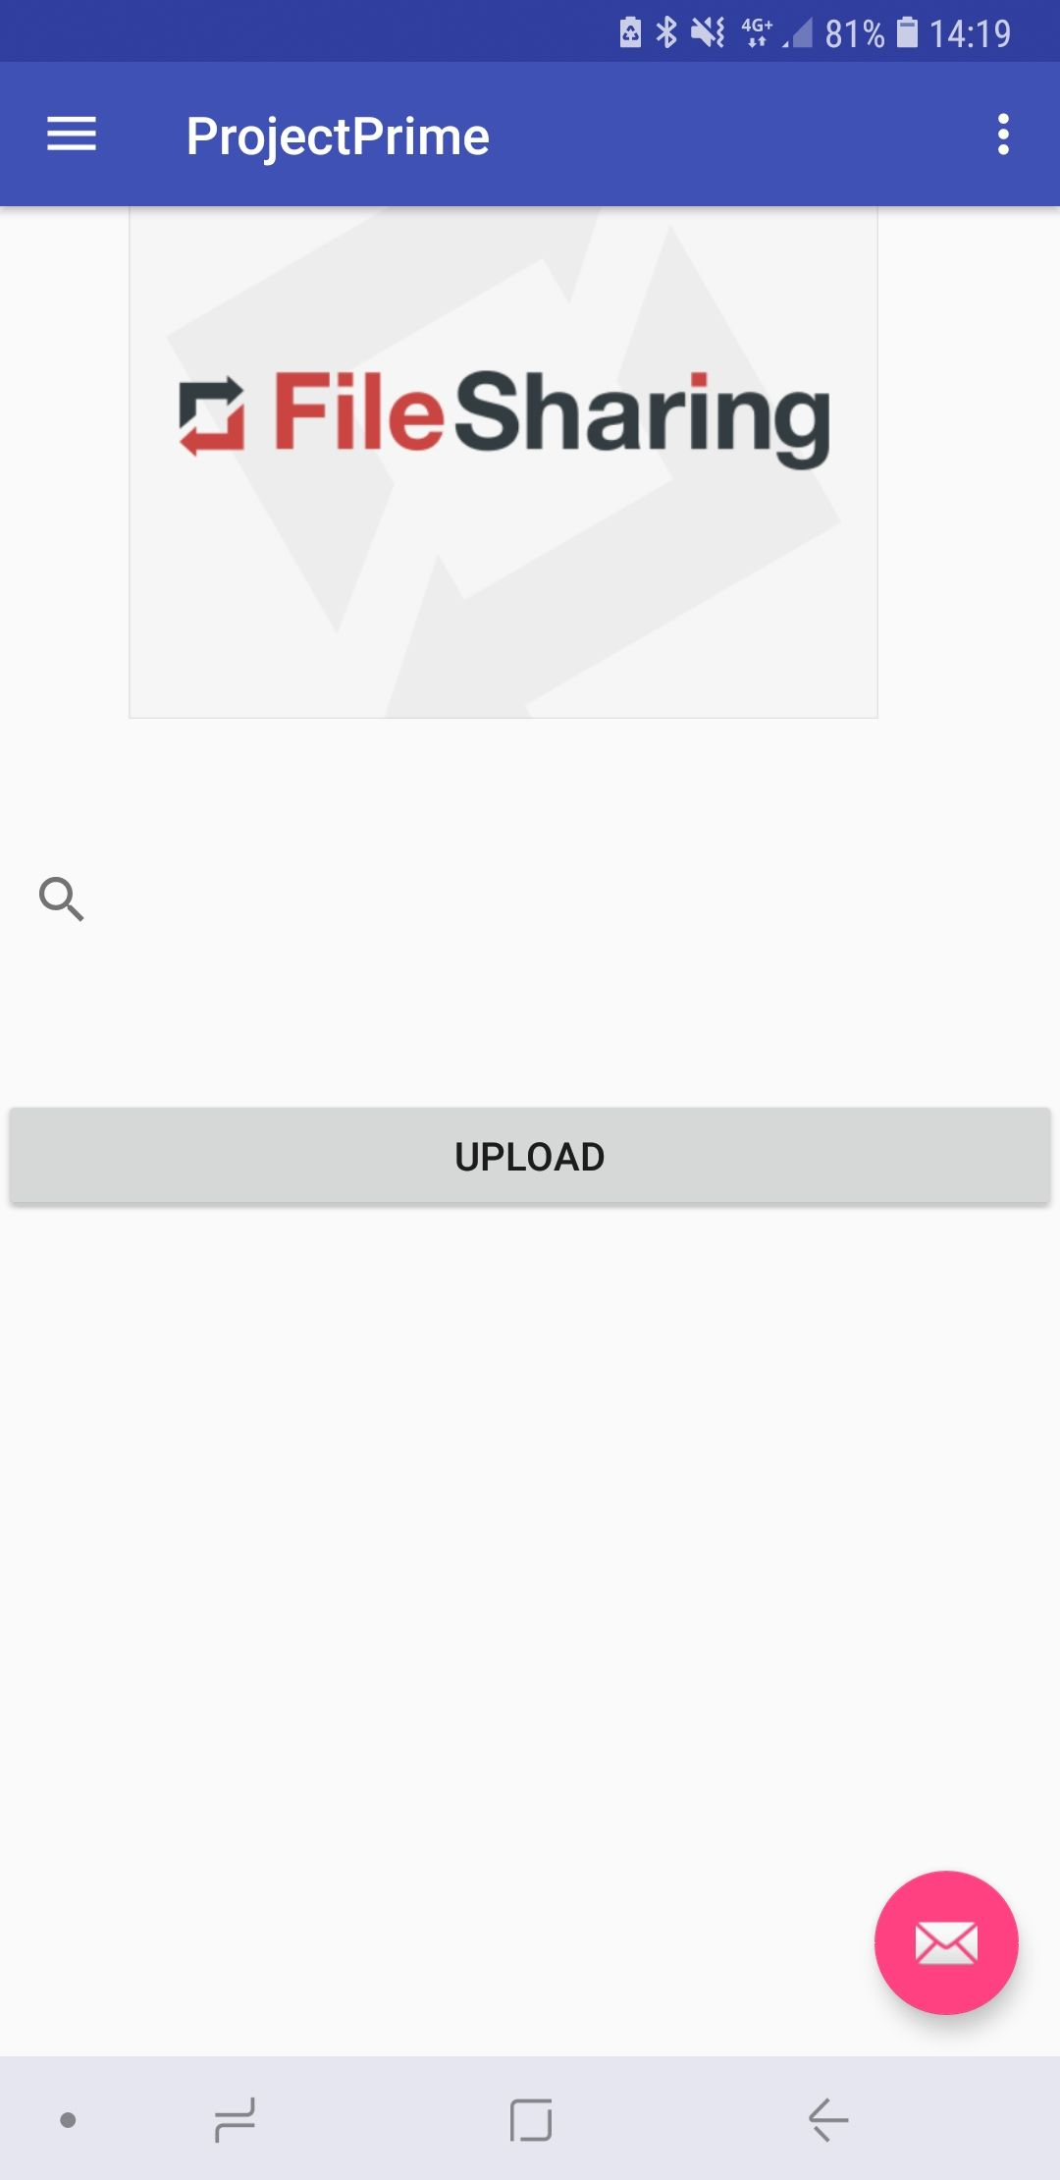
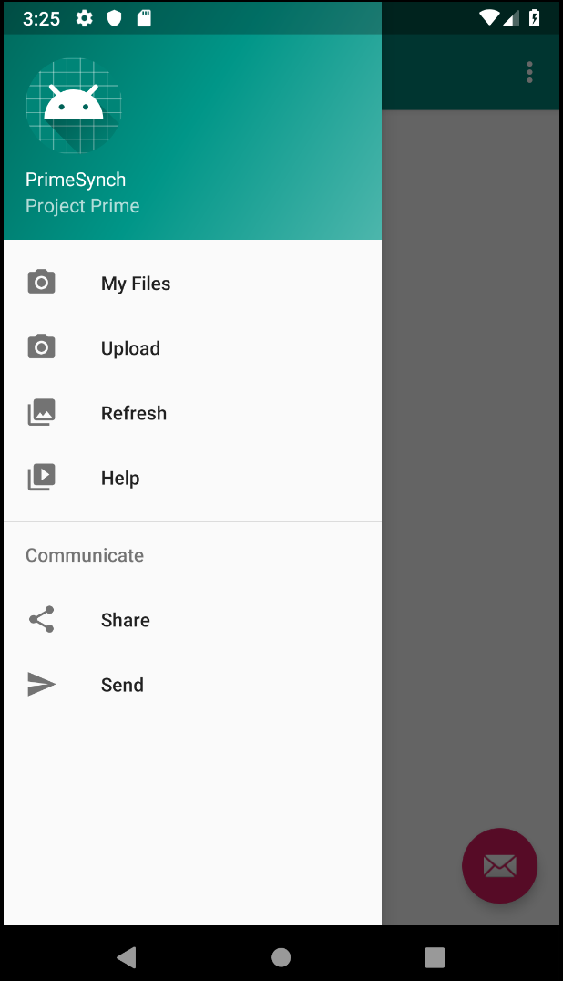
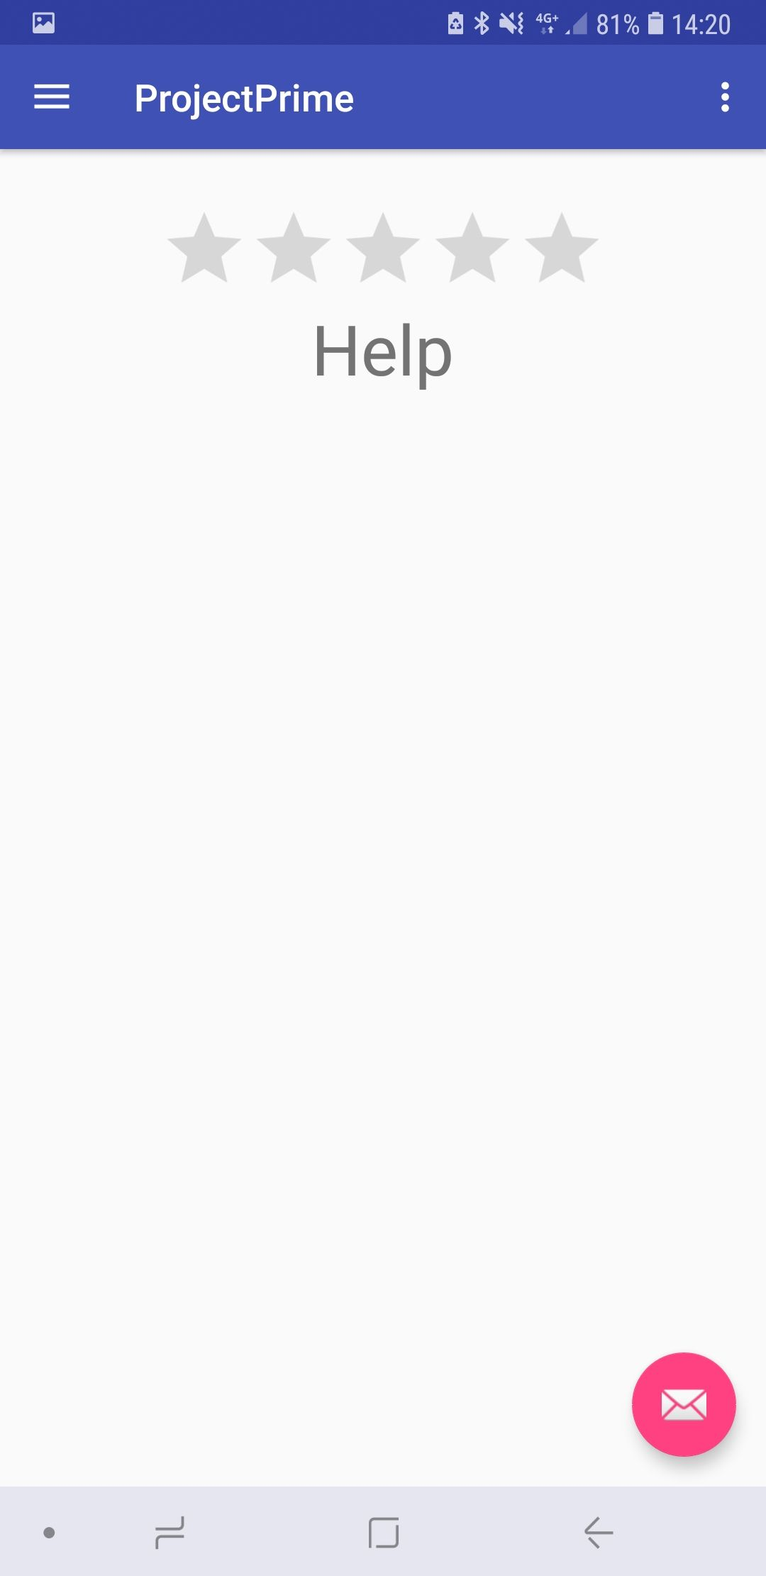
Mobile Application
Android Studio
Java for navigation and code
Xml code for UI
Libraries
Node.js
Features
View Files
Search
Upload
Refresh
Help

Slide 7
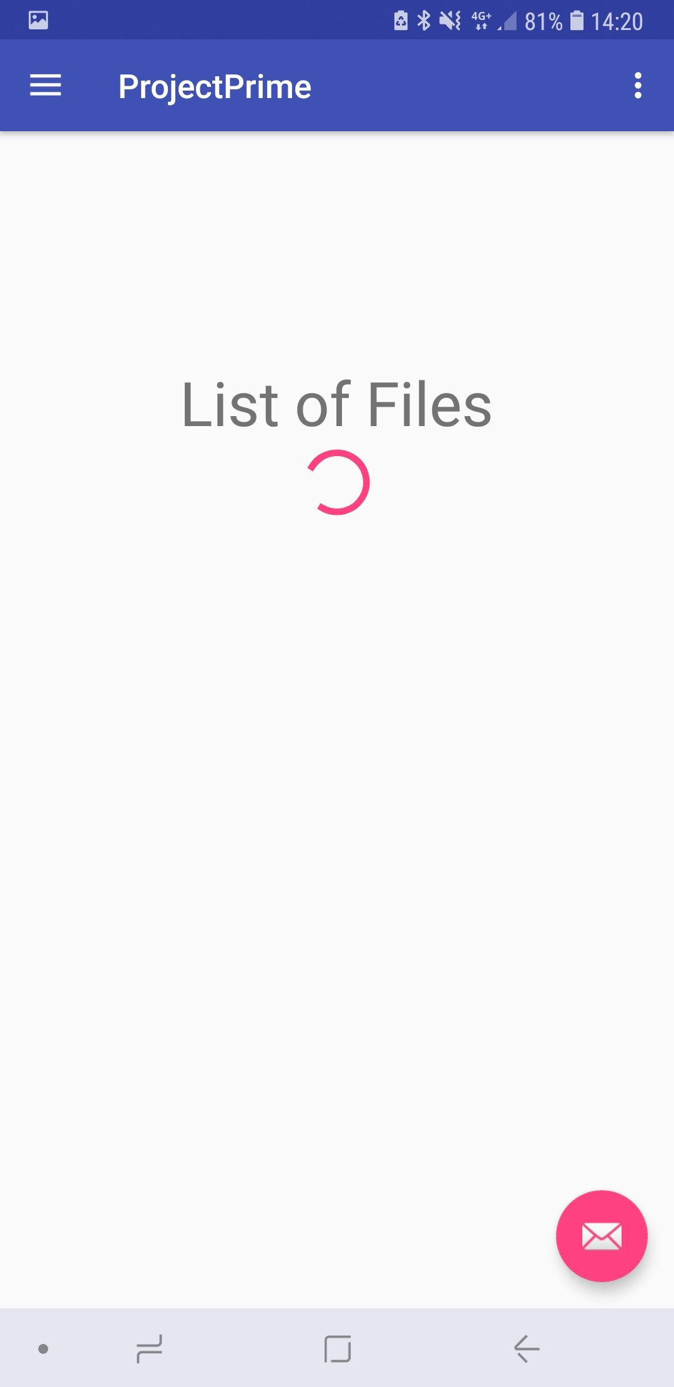
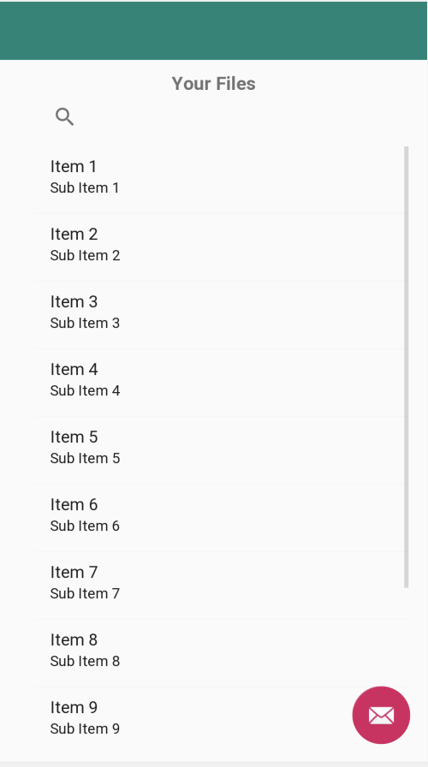
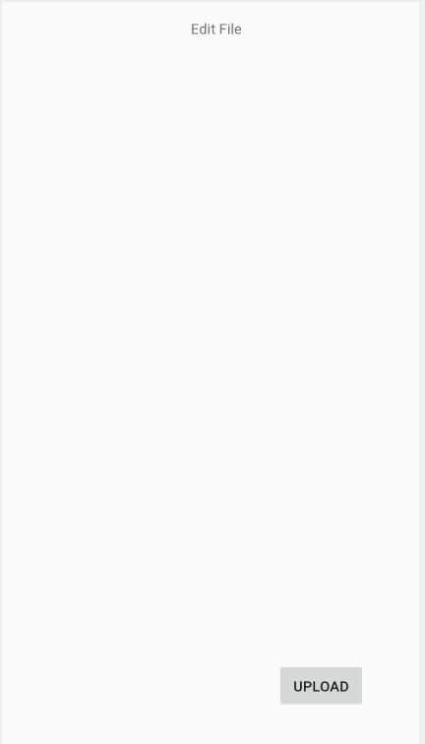
App Design/Progress
Design
Minimalistic
Simple
Focus on 2 Main pages
Progress
Initial Design complete
Server connection still to do

